Slide 1
FOUNDATIONS OF PROBABILITY
BHAVYA H
STATISTICS PROFESSIONAL
SPOCTEC TECHNOLOGICAL AND RESEARCH CENTRE

Slide 2
Probability Theory
Probability – Models for random phenomena

Slide 3
Phenomena
Non-deterministic
Deterministic

Slide 4
Deterministic Phenomena
There exists a mathematical model that allows “perfect” prediction the phenomena’s outcome.
Many examples exist in Physics, Chemistry (the exact sciences).
Non-deterministic Phenomena
No mathematical model exists that allows “perfect” prediction the phenomena’s outcome.

Slide 5
Non-deterministic Phenomena
may be divided into two groups.
Random phenomena
Unable to predict the outcomes, but in the long-run, the outcomes exhibit statistical regularity.
Haphazard phenomena
unpredictable outcomes, but no long-run, exhibition of statistical regularity in the outcomes.

Slide 6
Phenomena
Non-deterministic
Deterministic
Haphazard
Random

Slide 7
Haphazard phenomena
unpredictable outcomes, but no long-run, exhibition of statistical regularity in the outcomes.
Do such phenomena exist?
Will any non-deterministic phenomena exhibit long-run statistical regularity eventually?

Slide 8
Random phenomena
Unable to predict the outcomes, but in the long-run, the outcomes exhibit statistical regularity.
Examples
Tossing a coin – outcomes S ={Head, Tail}
Unable to predict on each toss whether is Head or Tail.
In the long run can predict that 50% of the time heads will occur and 50% of the time tails will occur

Slide 9
Rolling a die – outcomes
S ={ , , , , , }
Unable to predict outcome but in the long run can one can determine that each outcome will occur 1/6 of the time.
Use symmetry. Each side is the same. One side should not occur more frequently than another side in the long run. If the die is not balanced this may not be true.

Slide 10
Definitions

Slide 11
The sample Space, S
The sample space, S, for a random phenomena is the set of all possible outcomes.

Slide 12
Examples
Tossing a coin – outcomes S ={Head, Tail}
Rolling a die – outcomes
S ={ , , , , , }
={1, 2, 3, 4, 5, 6}

Slide 13
An Event , E
The event, E, is any subset of the sample space, S. i.e. any set of outcomes (not necessarily all outcomes) of the random phenomena
S
E

Slide 14
The event, E, is said to have occurred if after the outcome has been observed the outcome lies in E.
S
E

Slide 15
Examples
Rolling a die – outcomes
S ={ , , , , , }
={1, 2, 3, 4, 5, 6}
E = the event that an even number is rolled
= {2, 4, 6}
={ , , }

Slide 16
Special Events
The Null Event, The empty event - φ
φ = { } = the event that contains no outcomes
The Entire Event, The Sample Space - S
S = the event that contains all outcomes
The empty event, φ , never occurs.
The entire event, S, always occurs.

Slide 17
Set operations on Events
Union
Let A and B be two events, then the union of A and B is the event (denoted by A∪B) defined by:
A ∪ B = {e| e belongs to A or e belongs to B}
A ∪ B
A
B

Slide 18
The event A ∪ B occurs if the event A occurs or the event and B occurs .
A ∪ B
A
B

Slide 19
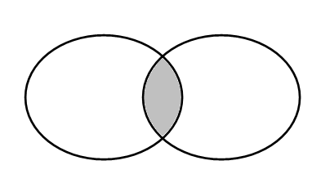
Intersection
Let A and B be two events, then the intersection of A and B is the event (denoted by A∩B) defined by:
A ∩ B = {e| e belongs to A and e belongs to B}
A ∩ B
A
B

Slide 20
The event A ∩ B occurs if the event A occurs and the event and B occurs .
A ∩ B
A
B

Slide 21
Complement
Let A be any event, then the complement of A (denoted by ) defined by:
= {e| e does not belong to A}
A

Slide 22
The event occurs if the event A does not occur
A

Slide 23
In problems you will recognize that you are working with:
Union if you see the word or,
Intersection if you see the word and,
Complement if you see the word not.

Slide 24
Definition: mutually exclusive
Two events A and B are called mutually exclusive if:
A
B

Slide 25
If two events A and B are are mutually exclusive then:
They have no outcomes in common. They can’t occur at the same time. The outcome of the random experiment can not belong to both A and B.
A
B

Slide 26
Probability

Slide 27
Basic terminologies
Experiment
Any process of observation that has an uncertain outcome.
Independent Events
The occurrence of one event in no way influences the probability of the occurrence of the other event.
Dependent Events
The occurrence of one event impacts the probability of the other event occurring.

Slide 28
Equally likely
Taking into consideration all the relevant evidences, there is no reason to expect one in preference to the others.

Slide 29
Probability of an event : a number assigned to an event Pr(A)
Axiom 1: Pr(A) ≥ 0
Axiom 2: Pr(S) = 1
Axiom 3: For every sequence of disjoint events

Slide 30
Definition: probability of an Event E.
Suppose that the sample space S = {o₁, o₂, o₃, … o_{N}} has a finite number, N, of outcomes.
Also each of the outcomes is equally likely.
Then for any event E

Slide 31
Thus this definition of P[E], i.e.
Applies only to the special case when
The sample space has a finite no.of outcomes, and
Each outcome is equi-probable
If this is not true a more general definition of probability is required.

Slide 32
Rules of Probability

Slide 33
The additive rule (Mutually exclusive events)
P[A ∪ B] = P[A] + P[B]
i.e.
P[A or B] = P[A] + P[B]
if A ∩ B = φ
(A and B mutually exclusive)

Slide 34
If two events A and B are are mutually exclusive then:
They have no outcomes in common. They can’t occur at the same time. The outcome of the random experiment can not belong to both A and B.
A
B

Slide 35
P[A ∪ B] = P[A] + P[B]
i.e.
P[A or B] = P[A] + P[B]
A
B

Slide 36
The additive rule
(In general)
P[A ∪ B] = P[A] + P[B] – P[A ∩ B]
or
P[A or B] = P[A] + P[B] – P[A and B]

Slide 37
Logic
When P[A] is added to P[B] the outcome in A ∩ B are counted twice
hence
P[A ∪ B] = P[A] + P[B] – P[A ∩ B]

Slide 38
Example: Bangalore and Dharwad are two of the cities competing for the National university games. (There are also many others). The organizers are narrowing the competition to the final 5 cities. There is a 20% chance that Bangalore will be amongst the final 5. There is a 35% chance that Dharwad will be amongst the final 5 and an 8% chance that both Bangalore and Dharwad will be amongst the final 5. What is the probability that Bangalore or Dharwad will be amongst the final 5.

Slide 39
Solution: Let A = the event that Bangalore is amongst the final 5. Let B = the event that Dharwad is amongst the final 5. Given P[A] = 0.20, P[B] = 0.35, and P[A ∩ B] = 0.08 What is P[A ∪ B]? Note: “and” ≡ ∩, “or” ≡ ∪ .

Slide 40
Rule for complements
or

Slide 41
Complement
Let A be any event, then the complement of A (denoted by ) defined by:
= {e| e does not belongs to A}
A

Slide 42
The event occurs if the event A does not occur
A

Slide 43
Logic:
A

Slide 44
Joint Probability
For events A and B, joint probability Pr(AB) stands for the probability that both events happen.
Example: A={HH}, B={HT, TH}, what is the joint probability Pr(AB)?

Slide 45
Independence
Two events A and B are independent in case
Pr(AB) = Pr(A)Pr(B)
A set of events {A_{i}} is independent in case

Slide 46
Independence
Two events A and B are independent in case
Pr(AB) = Pr(A)Pr(B)
A set of events {A_{i}} is independent in case
Example: Drug test
A = {A patient is a Women}
B = {Drug fails}
Will event A be independent from event B ?
 | Women | Men
Success | 200 | 1800
Failure | 1800 | 200

Slide 47
Independence
Consider the experiment of tossing a coin twice
Example I:
A = {HT, HH}, B = {HT}
Will event A independent from event B?
Example II:
A = {HT}, B = {TH}
Will event A independent from event B?
Disjoint ≠ Independence
If A is independent from B, B is independent from C, will A be independent from C?

Slide 48
Conditional Probability

Slide 49
Conditional Probability
Frequently before observing the outcome of a random experiment you are given information regarding the outcome
How should this information be used in prediction of the outcome.
Namely, how should probabilities be adjusted to take into account this information
Usually the information is given in the following form: You are told that the outcome belongs to a given event. (i.e. you are told that a certain event has occurred)

Slide 50
Definition
Suppose that we are interested in computing the probability of event A and we have been told event B has occurred.
Then the conditional probability of A given B is defined to be:

Slide 51
Rationale:
If we’re told that event B has occurred then the sample space is restricted to B.
The probability within B has to be normalized, This is achieved by dividing by P[B]
The event A can now only occur if the outcome is in of A ∩ B. Hence the new probability of A is:
A
B
A ∩ B

Slide 52
An Example
For a specific married couple the probability that the husband watches the show is 80%, the probability that his wife watches the show is 65%, while the probability that they both watch the show is 60%.
If the husband is watching the show, what is the probability that his wife is also watching the show

Slide 53
Solution:
Let B = the event that the husband watches the show
P[B]= 0.80
Let A = the event that his wife watches the show
P[A]= 0.65 and P[A ∩ B]= 0.60

Slide 54
Independence

Slide 55
Definition
Two events A and B are called independent if

Slide 56
Note
Thus in the case of independence the conditional probability of an event is not affected by the knowledge of the other event

Slide 57
Difference between independence and mutually exclusive
mutually exclusive
Two mutually exclusive events are independent only in the special case where
Mutually exclusive events are highly dependent otherwise. A and B cannot occur simultaneously. If one event occurs the other event does not occur.
A
B

Slide 58
Independent events
or
S
B
A
The ratio of the probability of the set A within B is the same as the ratio of the probability of the set A within the entire sample S.

Slide 59
The multiplicative rule of probability
and
if A and B are independent.

Slide 60
Summary of the Rules of Probability

Slide 61
The additive rule
P[A ∪ B] = P[A] + P[B] – P[A ∩ B]
and
if P[A ∩ B] = φ
P[A ∪ B] = P[A] + P[B]

Slide 62
The Rule for complements
for any event E

Slide 63
Conditional probability

Slide 64
The multiplicative rule of probability
and
if A and B are independent.
This is the definition of independent

Slide 65
Finite uniform probability space
Many examples fall into this category
Finite number of outcomes
All outcomes are equally likely
To handle problems in case we have to be able to count. Count n(E) and n(S).

Slide 66
Important Notes
In combinations ordering is irrelevant. Different orderings result in the same combination.
In permutations order is relevant. Different orderings result in the different permutations.

Slide 67
Basic counting formulae
Orderings
Permutations
The number of ways that you can choose k objects from n in a specific order
Combinations
The number of ways that you can choose k objects from n (order of selection irrelevant)

Slide 68
Conditioning
If A and B are events with Pr(A) > 0, the conditional probability of B given A is

Slide 69
Conditioning
If A and B are events with Pr(A) > 0, the conditional probability of B given A is
Example: Drug test
A = {Patient is a Women}
B = {Drug fails}
Pr(B|A) = ?
Pr(A|B) = ?
 | Women | Men
Success | 200 | 1800
Failure | 1800 | 200

Slide 70
Conditioning
If A and B are events with Pr(A) > 0, the conditional probability of B given A is
Example: Drug test
Given A is independent from B, what is the relationship between Pr(A|B) and Pr(A)?
A = {Patient is a Women}
B = {Drug fails}
Pr(B|A) = ?
Pr(A|B) = ?
 | Women | Men
Success | 200 | 1800
Failure | 1800 | 200

Slide 71
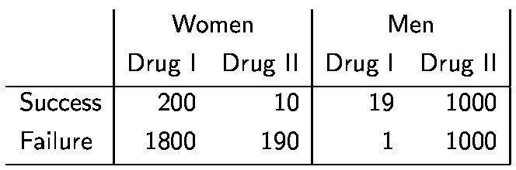
Which Drug is Better ?

Slide 72
BAYES THEOREM

Slide 73
Probability Revision using Bayes’ Theorem
Prior
Probabilities
New
Information
Application of
Bayes’
Theorem
Posterior
Probabilities

Slide 74
Definitions
Prior probability - the probability of an event before new information (finding) is acquired; pretest probability or risk
Posterior probability - the probability of an event after new information (finding) is acquired; posttest probability or risk
Probability revision - taking new information into account by converting prior probability to posterior probability

Slide 75
Bayes' Theorem
If are mutually disjoint events with then for any arbitrary event A which is a subset of such that , we have

Slide 76
A Simple Example
Mode of transport: Probability he is late:
Car 50%
Bus 20%
Train 1%
Suppose that Raju is late one day.
His boss wishes to estimate the probability that he traveled to work that day by car.
He does not know which mode of transportation Raju usually uses, so he gives a prior probability of 1 in 3 to each of the three possibilities.

Slide 77
P(A|B) = P(B|A) P(A) / P(B)
P(car|late) = P(late|car) x P(car) / P(late)
P(late|car) = 0.5 (he will be late half the time he drives)
P(car) = 0.33 (this is the boss' assumption)
P(late) = 0.5 x 0.33 + 0.2 x 0.33 + 0.01 x 0.33
(all the probabilities that he will be late added together)
P(car|late) = 0.5 x 0.33 / 0.5 x 0.33 + 0.2 x 0.33 + 0.01 x 0.33
= 0.165 / 0.71 x 0.33
= 0.7042

Slide 78
Random Variables and Distributions

Slide 79
Random Variable and Distribution
A random variable X is a numerical outcome of a random experiment
The distribution of a random variable is the collection of possible outcomes along with their probabilities:
Discrete case:
Continuous case:

Slide 80
Random Variable: Example
For example, if you roll a die, the outcome is random (not fixed) and there are 6 possible outcomes, each of which occur with probability one-sixth.

Slide 81
Random variables can be discrete or continuous
Discrete random variables have a countable number of outcomes
Examples: Dead/alive, treatment/placebo, dice, counts, etc.
Continuous random variables have an infinite continuum of possible values.
Examples: blood pressure, weight, the speed of a car, the real numbers from 1 to 6.

Slide 82
Probability functions
A probability function maps the possible values of x against their respective probabilities of occurrence, p(x)
p(x) is a number from 0 to 1.0.
The area under a probability function is always 1.
Notes:
It turns out that if you were to go out and sample many, many times, most sample statistics that you could calculate would follow a normal distribution.
What are the 2 parameters (from last time) that define any normal distribution?
Remember that a normal curve is characterized by two parameters, a mean and a variability (SD)
What do you think the mean value of a sample statistic would be? The standard deviation?
Remember standard deviation is natural variability of the population
Standard error can be standard error of the mean or standard error of the odds ratio or standard error of the difference of 2 means, etc. The standard error of any sample statistic.

Slide 83
The probability function that accompanies a discrete random variable is a discrete probability function that sums to 1 and called as Probability Mass Function.
The probability function that accompanies a continuous random variable is a continuous probability function that integrates to 1 and called as Probability Density Function.

Slide 84
Expected Value and Variance
All probability distributions are characterized by an expected value (mean) and a variance (standard deviation squared).

Slide 85
Expected value of a random variable
Expected value is just the average or mean (µ) of random variable x.
It’s sometimes called a “weighted average” because more frequent values of X are weighted more highly in the average.
It’s also how we expect X to behave on-average over the long run (“frequentist” view again).

Slide 86
Expected value, formally
Discrete case:
Continuous case:

Slide 87
Example: the lottery
The Lottery (also known as a tax on people who are bad at math…)
A certain lottery works by picking 6 numbers from 1 to 49. It costs Rs.1.00 to play the lottery, and if you win, you win Rs.20 lakh after taxes.
If you play the lottery once, what are your expected winnings or losses?

Slide 88
Lottery
Calculate the probability of winning in 1 try:
“49 choose 6”
Out of 49 numbers, this is the number of distinct combinations of 6.
The probability function (note, sums to 1.0):
Rs.x
p(x)
-1
.999999928
+ 20 lakh
7.2 x 10⁻⁻⁸

Slide 89
Expected Value
The probability function
Rs. x
p(x)
-1
.999999928
+ 20 lakh
7.2 x 10⁻⁻⁸
Expected Value
E(X) = P(win)*$2,000,000 + P(lose)*-$1.00
= 2.0 x 10⁶ * 7.2 x 10⁻⁸+ .999999928 (-1) = .144 - .999999928 = -$.86
Negative expected value is never good!
You shouldn’t play if you expect to lose money!

Slide 90
Expected Value
If you play the lottery every week for 10 years, what are your expected winnings or losses?
520 x (-.86) = -$447.20

Slide 91
Variance/standard deviation
σ²=Var(x) =E(x-μ)²
“The expected (or average) squared distance (or deviation) from the mean”

Slide 92
Variance, continuous
Discrete case:
Continuous case?:

Slide 93
Moments of probability distributions
The moments of a probability distribution are a way of characterising its position and shape.
Strong physical analogy with moments in mechanics of rigid bodies
Centre of gravity
Moment of inertia
Higher moments

Slide 94
Central (or Mean) Moments
The average of all the deviations of all observations in a dataset from the mean of the observations raised to the power r.

Slide 95
The r^{th} central moment of X
where μ = E(X) = the first moment of X about zero.

Slide 96
There are 4 central moments:
The first central moment, r=1, is the sum of the difference of each observation from the sample average (arithmetic mean), which always equals 0
The second central moment, r=2, is variance.

Slide 97
The third central moment, r=3, gives skewness.
Skewness describes how the sample differs in shape from a symmetrical distribution.
The skewness is measured using the moments ratio
For symmetric distributions it is zero and has positive value for positively skewed distributions and takes negative value for negatively skewed distributions

Slide 98
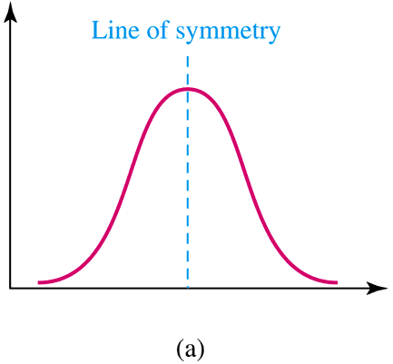
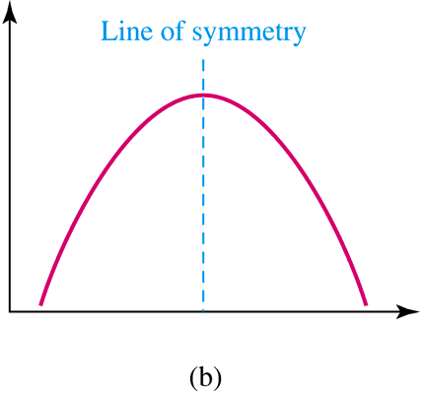
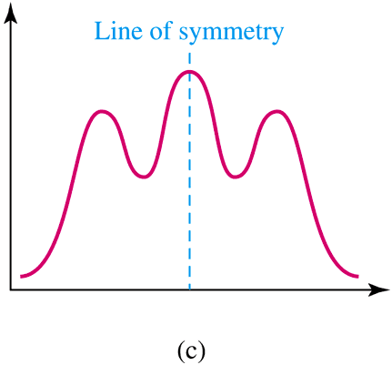
Symmetry or Skewness
A distribution is symmetric if its left half is a mirror image of its right half.
A symmetric distribution with a single peak and a bell shape is known as a normal distribution.

Slide 99
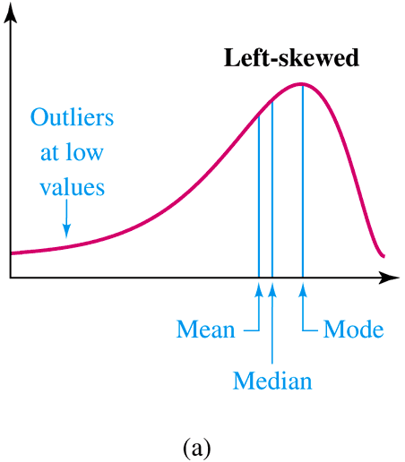
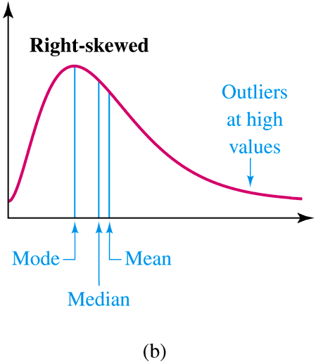
Symmetry or Skewness
A distribution is left-skewed
(or negatively skewed) if the values
are more spread out on the left,
meaning that some low values are
likely to be outliers.
A distribution is right skewed
or positively skewed if the
values are more spread out
on the right. It has a tail
pulled toward the right.

Slide 100
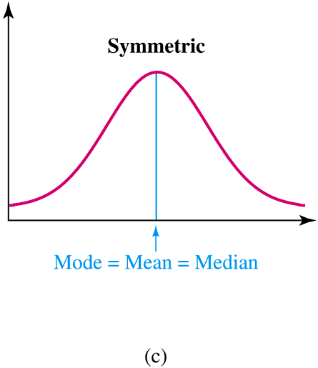

Slide 101
In a negatively(left) skewed distribution, the
mode > median > mean.

Slide 102
In a negatively(right) skewed distribution, the
mode < median < mean.

Slide 103
The 4th central moment measures kurtosis.
This is the “peakedness” of a distribution.
It measures the extent to which the data are distributed in the tails versus the center of the distribution

Slide 104
There are three types of peakedness.
Leptokurtic- very peaked
Platykurtic – relatively flat
Mesokurtic – in between

Slide 105
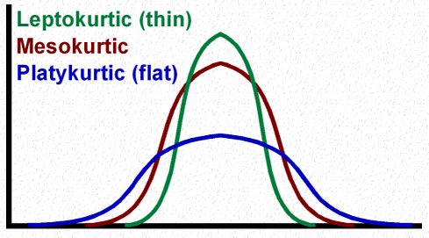
For a normal distribution, kurtosis is equal to 3.
When is greater than 3, the curve is more sharply peaked and has narrower tails than the normal curve and is said to be leptokurtic.
When it is less than 3, the curve has a flatter top and relatively wider tails than the normal curve and is said to be platykurtic.

Slide 106
The r^{th} moment of X about zero.

Slide 107
Relation between Moments about Mean and Moments about Origin

Slide 108
Moment generating functions

Slide 109
Moment Generating function of a R.V. X

Slide 110
Properties of Moment Generating Functions

Slide 111
m_{X}(0) = 1
Example

Slide 112
We use the expansion of the exponential function:

Slide 113
Now

Slide 114
Property 3 is very useful in determining the moments of a random variable X.
Examples

Slide 115
Let X be a random variable with moment generating function m_{X}(t). Let Y = bX + a
Then m_{Y}(t) = m_{bX + a}(t)
= E(e ^{[bX + a]t}) = e^{at}m_{X} (bt)
Let X and Y be two independent random variables with moment generating function m_{X}(t) and m_{Y}(t) .
Then m_{X+Y}(t) = m_{X} (t) m_{Y} (t)

Slide 116
6. The moment generating function uniquely
determines the distribution. That is, if
then X and Y are identically distributed. This
means the two random variables must have
the same distribution.

Slide 117
PROBABILITY DISTRIBUTIONS

Slide 118
Binomial Probability Distribution
A fixed number of observations (trials), n
e.g., 15 tosses of a coin; 20 patients; 1000 people surveyed
A binary outcome
e.g., head or tail in each toss of a coin; disease or no disease
Generally called “success” and “failure”
Probability of success is p, probability of failure is 1 – p
Constant probability for each trial
e.g., Probability of getting a tail is the same each time we toss the coin

Slide 119
The trials of the experiment are independent of each other. This means that if one outcome is a success, this does not influence the chance of another outcome being a success.

Slide 120
The probability mass function of binomial distribution is
Where:
n is random sample size
x is number of successes ( when a success is defined as what we are looking for) and takes values x = 0, 1, …, n
n-x is number of failures
p is probability of success

Slide 121



Mean and variance of a binomial distribution
If $X∼B(n,p)$,
$$μ=E\left(X\right)=np$$
$σ^{2}$ = var(X) = $np(1−p)$

Slide 122
Binomial distribution: example
If I toss a coin 20 times, what’s the probability of getting exactly 10 heads?

Slide 123
When there is a large number of trials, but a small probability of success, binomial calculation becomes impractical
Example: Number of deaths from horse kicks in the Army in different years

Slide 124
Approximation:
If n is large and p is small, then the Binomial distribution with parameters n and p, ( B(n;p) ), is well approximated by the Poisson distribution with parameter np, i.e. by the Poisson distribution with the same mean

Slide 125
The Poisson Distribution
Poisson distribution is applied where random events in space or time are expected to occur.

Slide 126
Properties of the Poisson Distribution
It is used to count the number of occurrences of an event within a given unit of time, area, volume, etc.
The probability that an event will occur within a given unit must be the same for all units.
The occurrence or nonoccurrence of an event in one unit is independent of an occurrence or nonoccurrence of an event in any other unit.

Slide 127
The probability mass function of Poisson distribution is defined by:
Where:
x is the number of events occurring in a defined unit.
λ is the expected value or mean value of occurrences within an unit.
The parameter λ is both the mean and the variance of the Poisson distribution.

Slide 128
Example
For example, if new cases of Dengue in Kolkata are occurring at a rate of about 2 per month, then these are the probabilities that: 0,1, 2, 3, 4, 5, 6, to 1000 to 1 million to… cases will occur in Kolkata in the next month:

Slide 129
Poisson Probability table
X
P(X)
0
=.135
1
=.27
2
=.27
3
=.18
4
=.09
5
…
…

Slide 130
The Geometric Distribution
Suppose an experiment consists of a sequence of trials with the following conditions:
The trials are independent.
Each trial can result in one of two possible outcomes, success and failure.
The probability of success is the same for all trials.
A geometric random variable is defined as
x = number of trials until the first success is observed (including the success trial)

Slide 131
If x is a geometric random variable with probability of success p for each trial, then its probability mass function is

Slide 132
Example
A sharpshooter normally hits the target 70% of the time.
Find the probability that her first hit is on the second shot.
P(2) = p(1-p) ^{n-1}
= .7(.3)²⁻¹
= 0.21

Slide 133
Normal Distributions
A random variable X with mean μ and standard deviation σ is normally distributed if its probability density function is given by
where

Slide 134
The Normal Distribution
f(X)
Changing μ shifts the distribution left or right.
Changing σ increases or decreases the spread.
σ
μ
X

Slide 135
PROPERTIES
It is unimodal; that is, the normal distribution peaks at a single value.
It is symmetric; this means that the two areas under the curve between the mean and any two points equidistant on either side of the mean are identical. One side of the distribution is the mirror image of the other side.
The mean, median, and mode are equal.
The tails of the normal curve approaches the horizontal axis on either side of the mean toward plus and minus infinity.
The amount of variation in the random variable determines the height and spread of the normal distribution.

Slide 136
The beauty of the normal curve:
No matter what μ and σ are,
The area between μ-σ and μ+σ is about 68%;
The area between μ-2σ and μ+2σ is about 95%; and
The area between μ-3σ and μ+3σ is about 99.7%. Almost all values fall within 3 standard deviations.

Slide 137
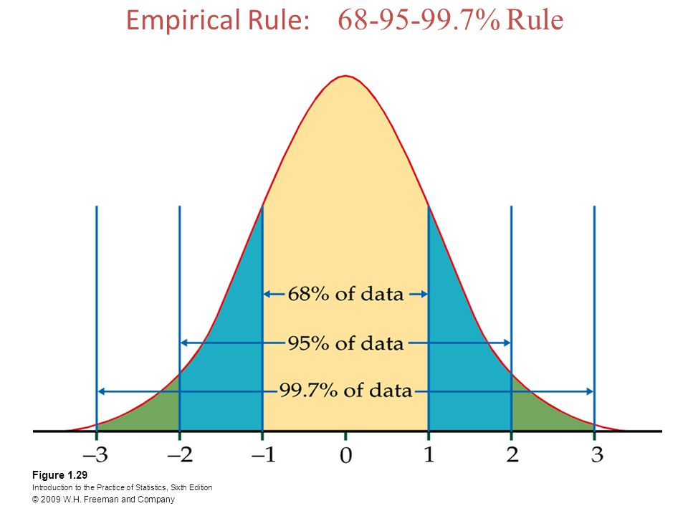

Slide 138
The Standard Normal Distribution (Z)
All normal distributions can be converted into the standard normal curve by subtracting the mean and dividing by the standard deviation:

Slide 139
The Standard Normal (Z):
The formula for the standardized normal probability density function is

Slide 140
Example - Adult Female Heights
What is the probability a randomly selected female is 5’10” or taller (70 inches)?
Step 1 - Y ~ N(63.7 , 2.5)
Step 2 - Y_{L} = 70.0 Y_{U} = ∞
Step 3 -
Step 4 - P(Y ≥ 70) = P(Z ≥ 2.52) = .0059 ( ≈ 1/170)

Slide 141
Are my data normally distributed?
Look at the histogram! Does it appear bell shaped?
Compute descriptive summary measures—are mean, median, and mode similar?
Do 2/3 of observations lie within 1 std dev of the mean? Do 95% of observations lie within 2 std dev of the mean?
Look at a normal probability plot—is it approximately linear?

Slide 142
LAW OF LARGE NUMBERS

Slide 143
According to Law of Large Numbers, if X₁, X₂,…, Xn are independent random variables having a common distribution with mean μ, then for any number ε > 0, no matter how small, as n → ∞,

Slide 144
CENTRAL LIMIT THEOREM

Slide 145
Central Limit Theorem: For simple random samples of n observations taken from a population with mean μ and standard deviation σ, regardless of the population’s distribution, provided the sample size is sufficiently large, the distribution of the sample means, , will be approximately normal with a mean equal to the population mean ( ) and a standard deviation equal to the population standard deviation divided by the square root of the sample size
( ).

